Slide 1
Simple Substitution Cipher Webpage
Jeff and Adrian

Slide 2
Utility
One segment of modern society that continues to use ancient cypher techniques are the criminals whose activities require some sort of written records “such as drug trafficking, loansharking, and illegal bookmaking. Incarcerated criminals also use cipher systems to communicate with cohorts inside and outside of prison” (Olson). These criminals tend to use simple substitution as their primary tool, with various modifications or alterations. The FBI has a history of investigating criminal communications dating back to their origins during prohibition when smugglers would use coded messages to communicate between local criminal organizations and their suppliers, often via shortwave radio with offshore ships. “From 1928 to 1930 the [U.S. Treasury Department’s] Cryptanalytic Unit decrypted approximately 12,000 messages for the Bureau of Customs, the Coast Guard, the Bureau of Narcotics, the Bureau of Internal Revenue, the Bureau of Prohibition, and the Department of Justice” (Mawry). This effort played a major part in developing cryptanalysis methods later used by the military and was significant to the later creation of the National Security Agency” (Mawry).

Slide 3
Code Snippets
function UseFrequencies()
//Make a list of character counts sorted to line up against the standard order.
freqCountSort = freqCount.slice();
freqCountSort.sort( function(a,b) {return a-b;} );
freqCountSort.reverse(); //freqCountSort is now the Counts in order
//find the letter matching each count (in order) and make the key point at it.
for(index=0;index<26; index++){
var count = freqCountSort[index];
var where = freqCount.indexOf(count);
keyArray[where] = freqOrder.charAt(index);
thisFreq += lowAlpha[where];
}
text += "new Key is: " + keyArray + "\n Click decrypt to try it.";
document.getElementById("plainText").value = text;
setKey(keyArray);

Slide 4
function spellCheck(){
getdic();
var result = localStorage.getItem("words");
var dictArray = result.split("\r");
var wordCount = 0;
var word = "";
var text = document.getElementById("plainText").value;
var re = /\r/gi;
var s1 = text.replace(re,"~");
var s2 = s1.replace( / /gi,"~");
var index;
var textArr = s2.split('~');
var textLength = textArr.length;
for(index = 0; index<textLength; index++){
if (textArr[index].length>0){
if (binarySearch(dictArray, textArr[index]) === 0) {
//do nothing
wordCount++;
}
}
}
document.getElementById("count").value = wordCount;
var test = document.getElementById("count").value;
}

Slide 5
function decrypt(){
var key = getKey();
var upAlpha = "ABCDEFGHIJKLMNOPQRSTUVWXYZ";
var plainText = "";
var cypherText = document.getElementById("cypherText").value.toUpperCase();
var plainChar, cypherChar, location;
for(var index=0;index<cypherText.length; index++){
cypherChar = cypherText.charAt(index);
location = upAlpha.indexOf(cypherChar);
if (location === -1){ // .indexOf is -1 for a non-upAlpha character
plainText += cypherChar; // copy all non-upAlpha char straight over
} else {
plainChar = key.charAt(location); // copy all alphabet chars via key
plainText += plainChar;
}
}
document.getElementById("plainText").value = plainText;
}

Slide 6
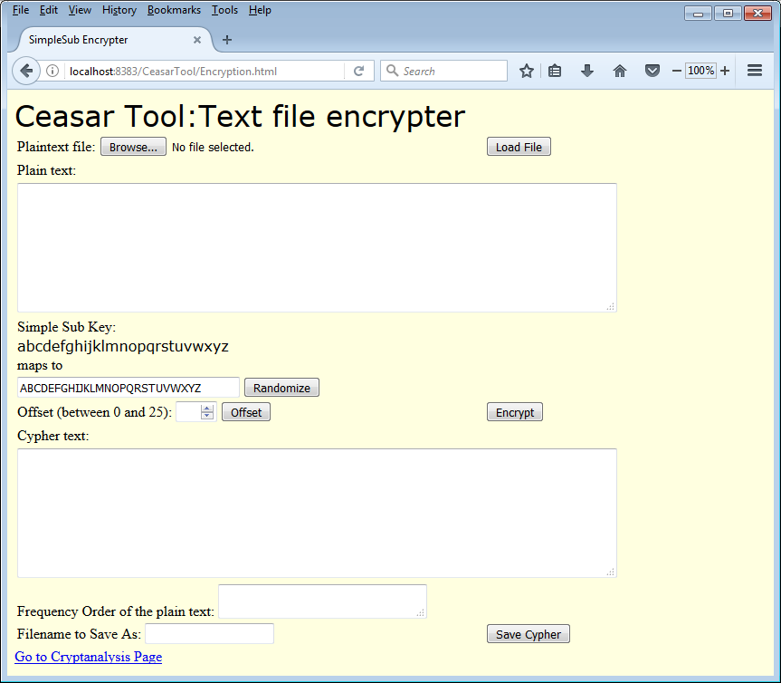
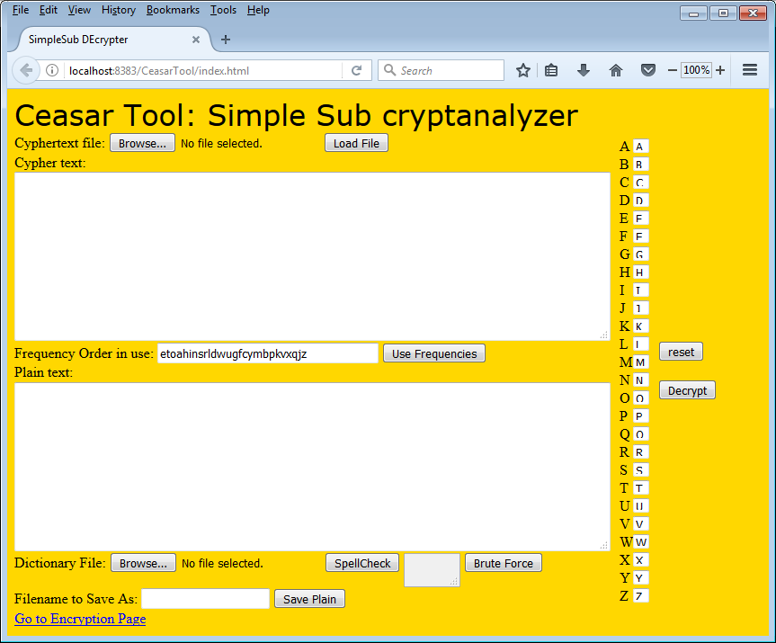
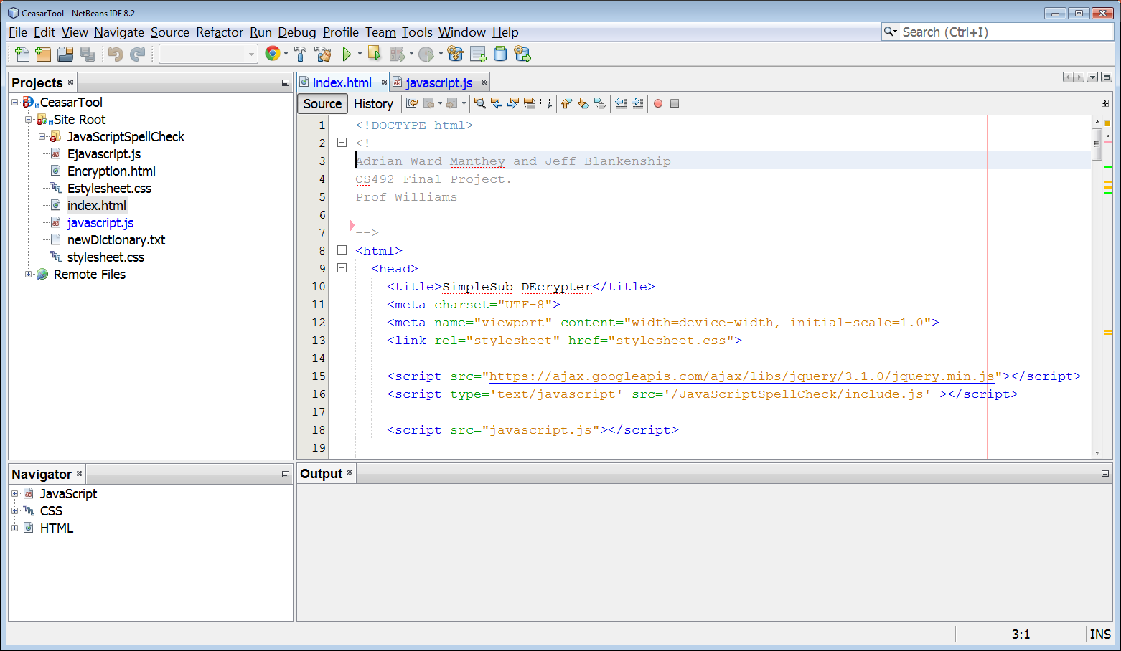
Time for a demo….
(or maybe a movie)

Slide 7
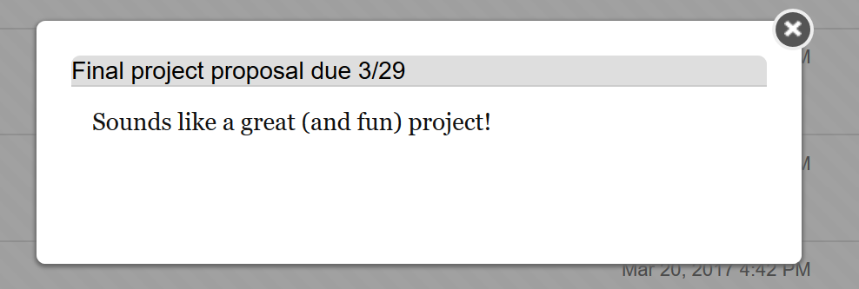
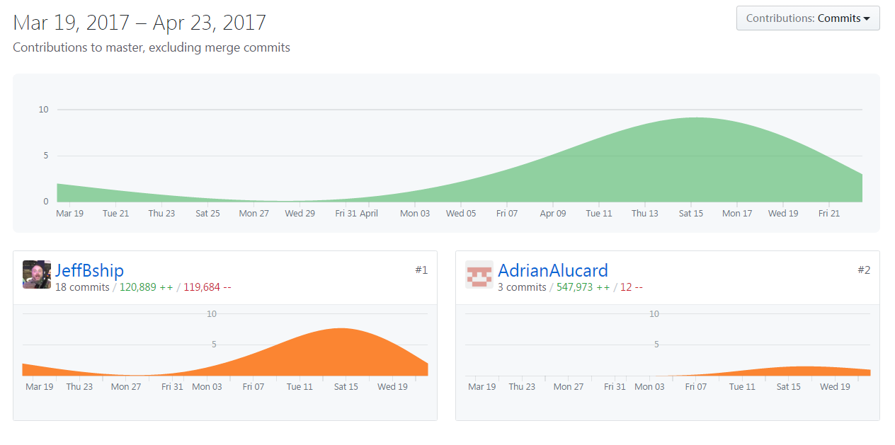

Slide 8
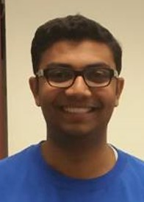
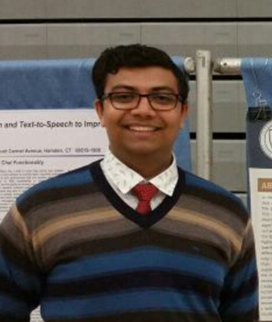
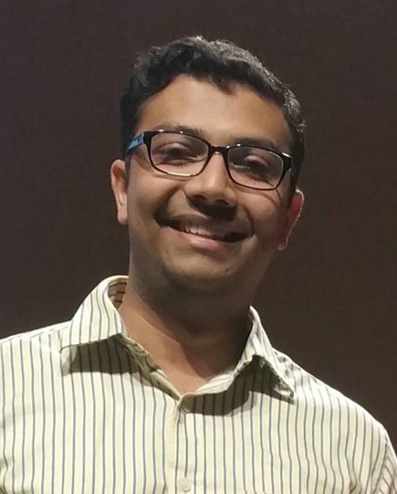



And a shout out to everyone’s inspirational leader:
FIN

